Slide 1
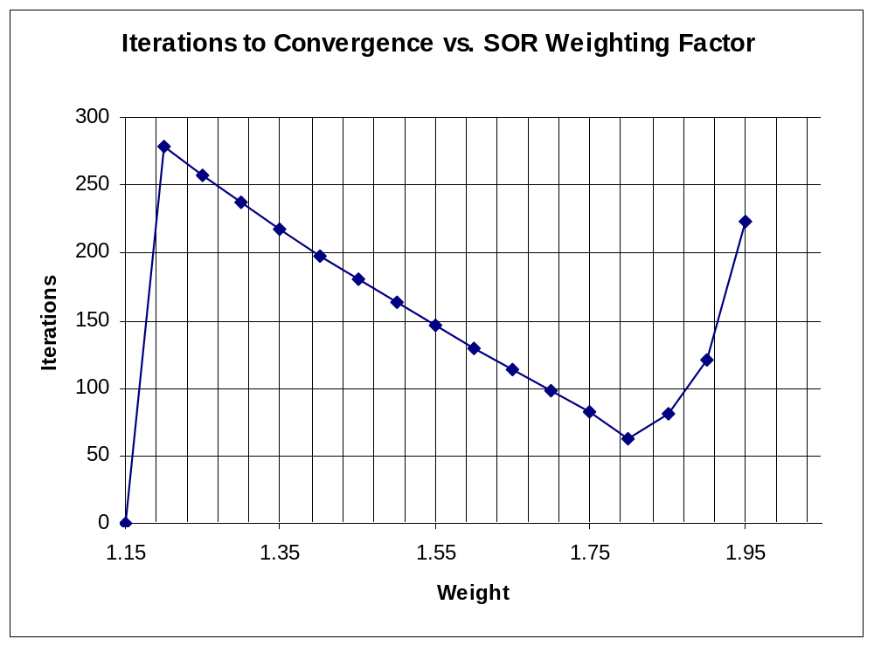
Successive Over-Relaxation (SOR)
Weight | Iterations
1 | -
1.05 | -
1.1 | -
1.15 | -
1.2 | 279
1.25 | 257
1.3 | 237
1.35 | 217
1.4 | 198
1.45 | 181
1.5 | 163
1.55 | 147
1.6 | 130
1.65 | 114
1.7 | 98
1.75 | 82
1.8 | 63
1.85 | 81
1.9 | 121
1.95 | 223
2 | -

